Slide 1

NIMS UNIVERSITY RAJASTHAN JAIPUR
Marik Institute of Computing, Artificial Intelligence, Robotics & Cybernetics
IoT Based Weather Monitoring Station Using ESP32
Presented By:
Veerti Jain (AIML 3 Sem)
Akshara Bhutra (AIML 3 Sem)
Guided By:
Mr. Sandeep Ramesh Sonaskar
(Senior Trainer IIoT Marik Digital Labs)

Slide 2
Introduction
The IoT Based Weather Monitoring Station is a smart embedded system that fetches live weather data over Wi-Fi and displays it in real time. The system uses a NodeMCU (ESP8266/ESP32 class Wi-Fi microcontroller) that connects to the internet and queries the OpenWeatherMap API for the current temperature, humidity and weather condition of a chosen city. The readings are shown live on a 16x2 I2C LCD display. The station refreshes its readings automatically every 10 minutes, demonstrating IoT connectivity, REST API integration, JSON parsing and embedded display control in a single low-cost project.

Slide 3
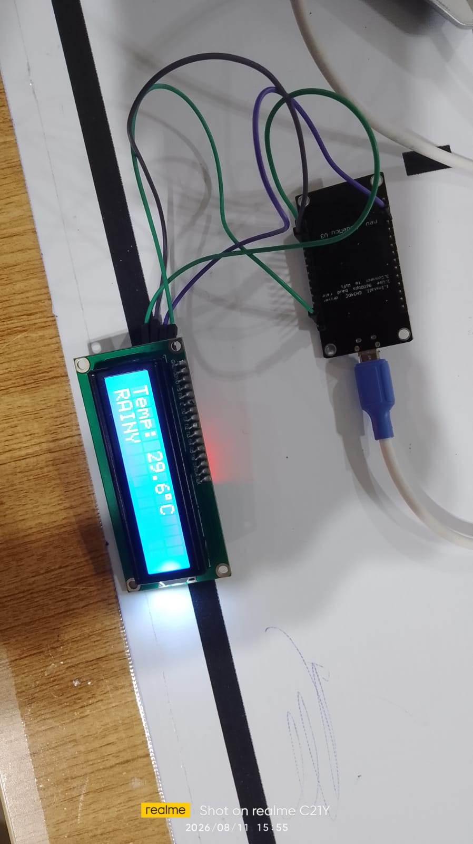
Circuit Diagram
Hardware Setup
NodeMCU Wi-Fi module (ESP8266/ESP32 class) – connects to the internet and calls the weather API
16x2 I2C LCD display (address 0x27) – shows live temperature and weather condition
USB power bank / adapter – powers the whole module

Slide 4
Arduino Code : Libraries & Configuration
#include <ESP8266WiFi.h>
#include <ESP8266HTTPClient.h>
#include <ArduinoJson.h>
#include <Wire.h>
#include <LiquidCrystal_I2C.h>
// ================================
// Wi-Fi DETAILS
// ================================
const char* ssid = "YOUR_WIFI_SSID";
const char* password = "YOUR_WIFI_PASSWORD";
// ================================
// OPENWEATHERMAP API
// ================================
const char* apiKey = "YOUR_OPENWEATHERMAP_API_KEY";
// Jaipur, Rajasthan, India
const char* city = "Jaipur,IN";
// ================================
// I2C LCD
// ================================
LiquidCrystal_I2C lcd(0x27, 16, 2);

Slide 5
Arduino Code : setup() Function
// ================================
// SETUP
// ================================
void setup() {
Serial.begin(115200);
lcd.init();
lcd.backlight();
lcd.setCursor(0, 0);
lcd.print("Jaipur Weather");
lcd.setCursor(0, 1);
lcd.print("Connecting WiFi");
WiFi.begin(ssid, password);
Serial.print("Connecting to WiFi");
while (WiFi.status() != WL_CONNECTED) {
delay(500);
Serial.print(".");
}
Serial.println("WiFi Connected!");
lcd.clear();
lcd.setCursor(0, 0);
lcd.print("WiFi Connected");
lcd.setCursor(0, 1);
lcd.print("Getting Weather");
delay(2000);
getWeather();
}

Slide 6
Arduino Code : loop() & Fetching Data
// ================================
// MAIN LOOP
// ================================
void loop() {
delay(600000); // update every 10 minutes
getWeather();
}
// ================================
// WEATHER FUNCTION
// ================================
void getWeather() {
if (WiFi.status() != WL_CONNECTED) {
Serial.println("WiFi disconnected!");
lcd.clear();
lcd.setCursor(0, 0);
lcd.print("WiFi Error");
return;
}
WiFiClient client;
HTTPClient http;
String url =
"http://api.openweathermap.org/data/2.5/weather?q=" +
String(city) + "&appid=" + String(apiKey) +
"&units=metric";
Serial.println("Getting Jaipur weather...");
http.begin(client, url);
int httpCode = http.GET();

Slide 7
Arduino Code : Parsing the JSON Response
if (httpCode == 200) {
String payload = http.getString();
Serial.println("Weather data received:");
DynamicJsonDocument doc(2048);
DeserializationError error = deserializeJson(doc, payload);
if (error) {
Serial.println("JSON parsing failed!");
lcd.clear();
lcd.setCursor(0, 0);
lcd.print("JSON Error");
http.end();
return;
}
float temperature = doc["main"]["temp"];
int humidity = doc["main"]["humidity"];
String weather = doc["weather"][0]["main"];
String description = doc["weather"][0]["description"];
Serial.println("------------------------");
Serial.print("Temperature: "); Serial.print(temperature); Serial.println(" C");
Serial.print("Humidity: "); Serial.print(humidity); Serial.println(" %");
Serial.print("Weather: "); Serial.println(weather);
Serial.print("Description: "); Serial.println(description);
Serial.println("------------------------");

Slide 8
Arduino Code : LCD Display & Error Handling
// ================================
// LCD DISPLAY
// ================================
lcd.clear();
lcd.setCursor(0, 0);
lcd.print("Temp: ");
lcd.print(temperature, 1);
lcd.print((char)223);
lcd.print("C");
lcd.setCursor(0, 1);
if (weather == "Clear") lcd.print("CLEAR");
else if (weather == "Clouds") lcd.print("CLOUDY");
else if (weather == "Rain") lcd.print("RAINY");
else if (weather == "Drizzle") lcd.print("DRIZZLE");
else if (weather == "Thunderstorm") lcd.print("STORM");
else lcd.print(weather);
}
else {
Serial.print("HTTP Error: ");
Serial.println(httpCode);
lcd.clear();
lcd.setCursor(0, 0);
lcd.print("Weather Error");
lcd.setCursor(0, 1);
lcd.print("Code: ");
lcd.print(httpCode);
}
http.end();
}

Slide 9
Working
1. On power-up, the NodeMCU connects to the configured Wi-Fi network and initializes the I2C LCD.
2. It sends an HTTP GET request to the OpenWeatherMap API for the configured city (Jaipur, IN).
3. The JSON response is parsed with ArduinoJson to extract temperature, humidity and weather condition.
4. The temperature and a short weather label (CLEAR, CLOUDY, RAINY, DRIZZLE or STORM) are printed on the 16x2 I2C LCD.
5. If the Wi-Fi connection drops or the API/JSON call fails, the LCD shows an error message with the HTTP status code instead of stale data.
6. The loop then waits 10 minutes and repeats the process, keeping the displayed weather information continuously up to date.

Slide 10
Result
Live Output
The module successfully connected to Wi-Fi and fetched live data from the OpenWeatherMap API for Jaipur, IN
The 16x2 I2C LCD correctly displayed the real-time temperature and weather condition, as seen in the photo below
Reading captured: Temp 29.6°C, Weather: RAINY, matching the actual conditions in Jaipur at the time of testing
The station kept refreshing automatically every 10 minutes without manual intervention or crashes during testing

Slide 11
Thank you !

